Slide 1
Automate invoice creation using Zoho flow

Slide 2
Implementation Stage 1: Accessing Zoho Flow
Log in to Zoho Flow with the necessary credentials.
Go to the Flows section.
Access the specific flow related to Zoho Books.

Slide 3
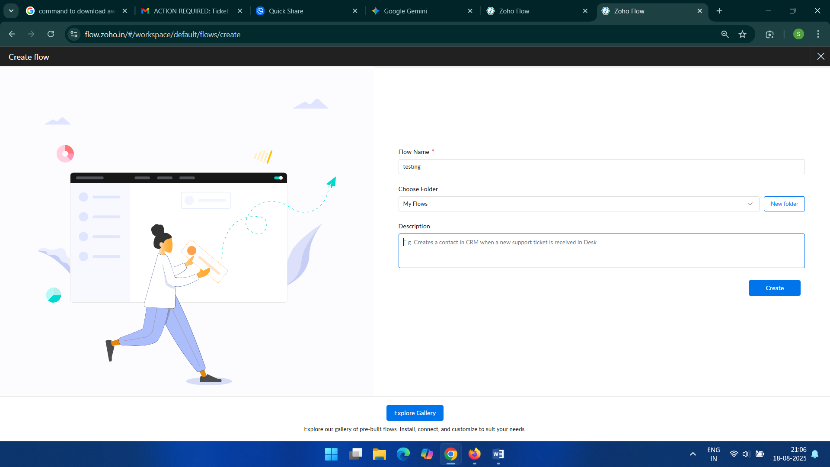

Slide 4
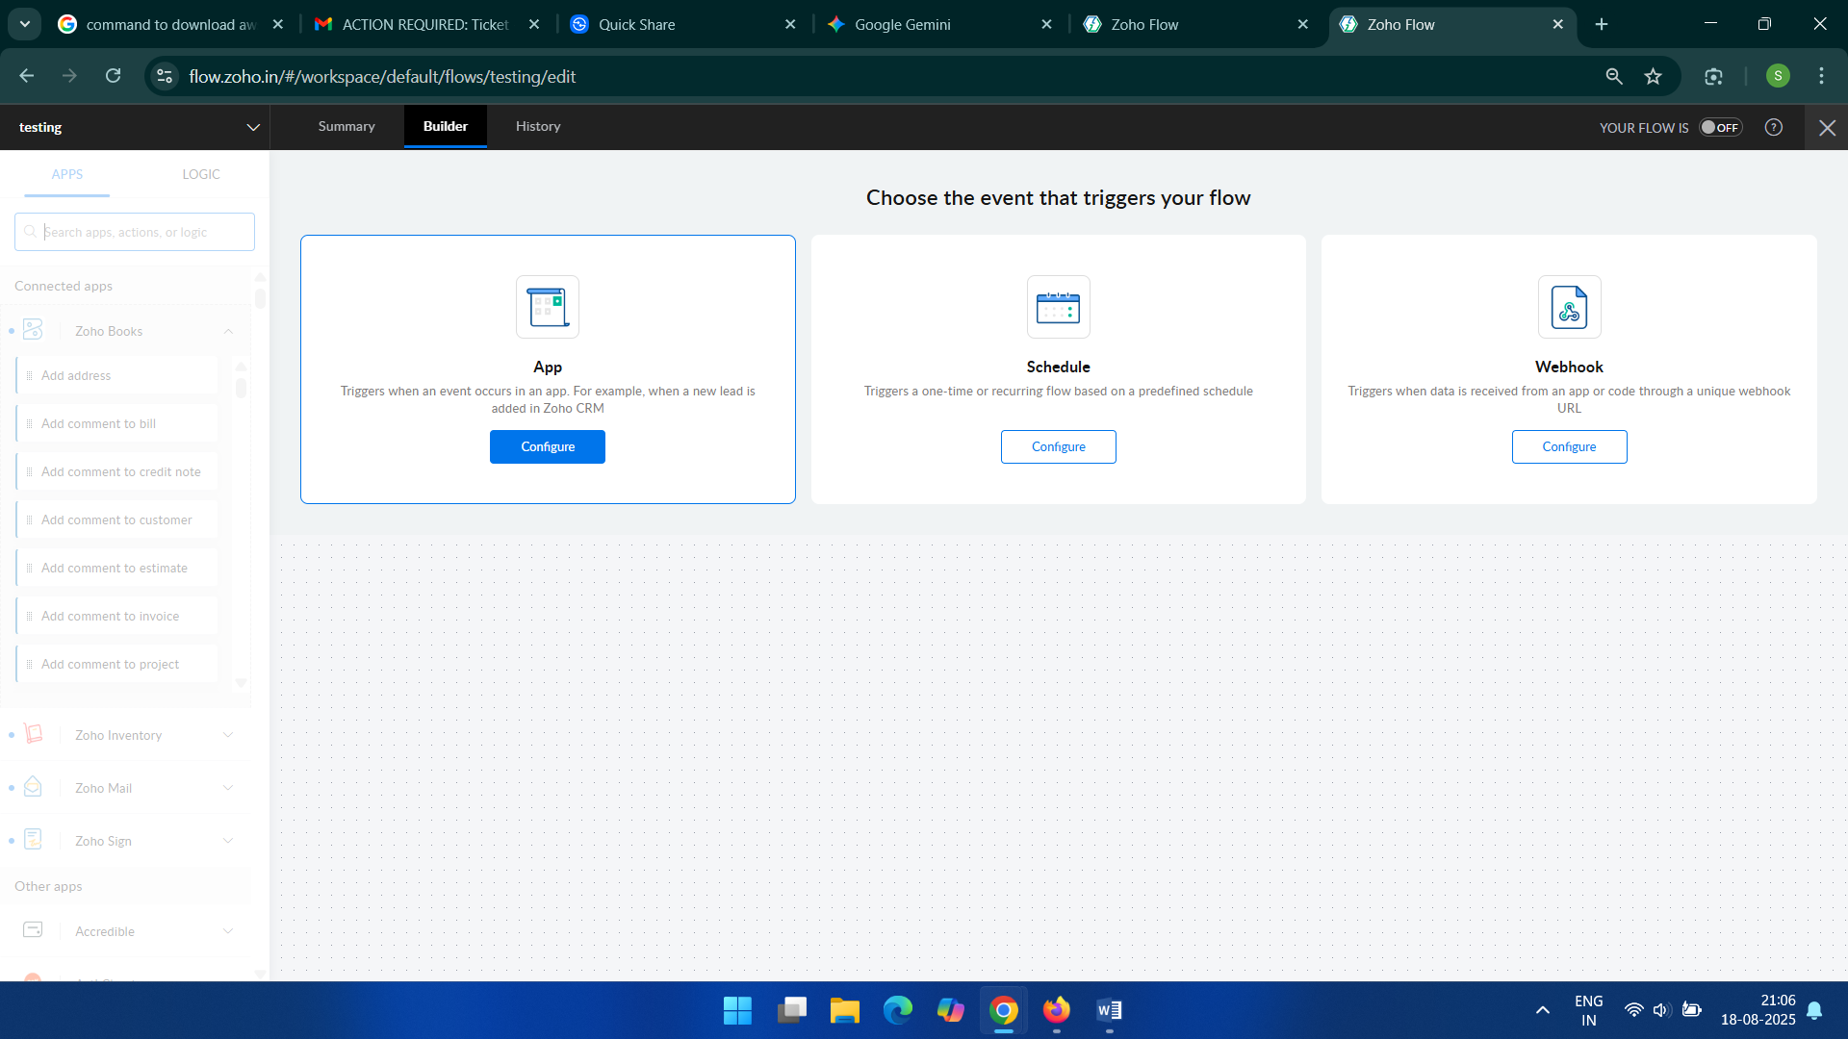

Slide 5
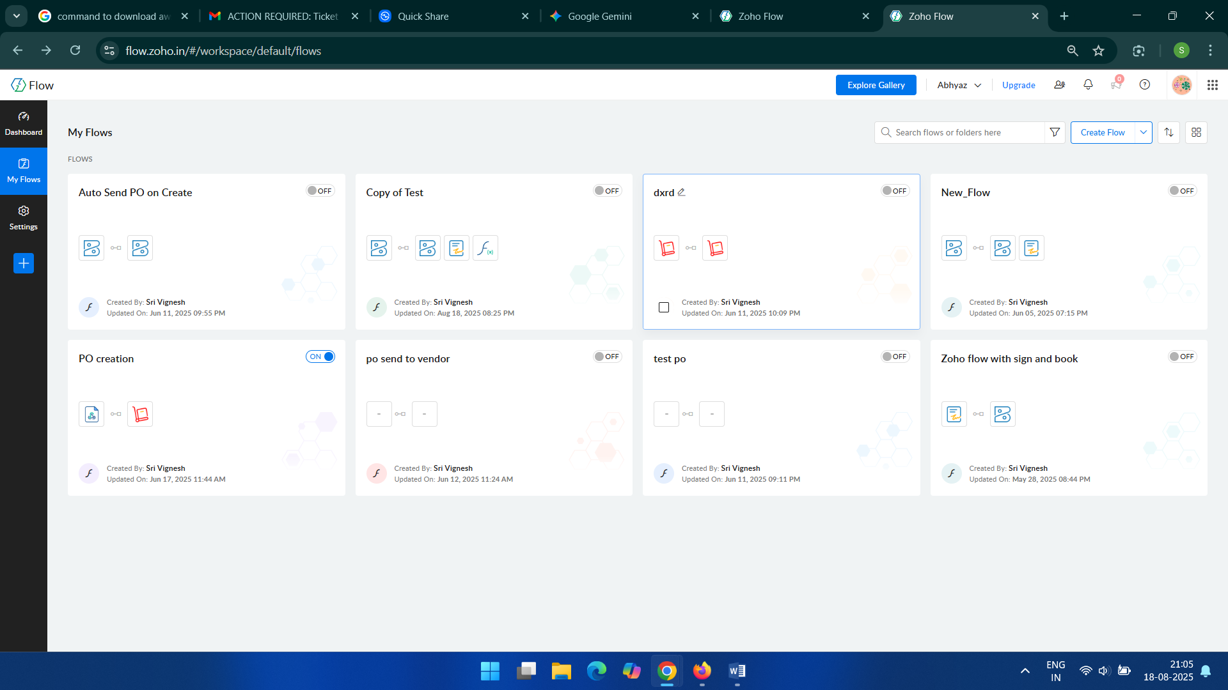

Slide 6
Implementation Stage 2: Creating the Automation Rule
Set the trigger to Zoho Books.
Select the trigger event as Invoice created.
Add the Fetch Invoice action to retrieve the invoice details.
Include the Send document action to email the invoice.
Add a Delay step to pause the workflow.
Add the Check invoicePaymentStatus action.
Use a Decision block to create conditional logic based on the payment status.
Add a final Send document action for a specific condition.

Slide 7
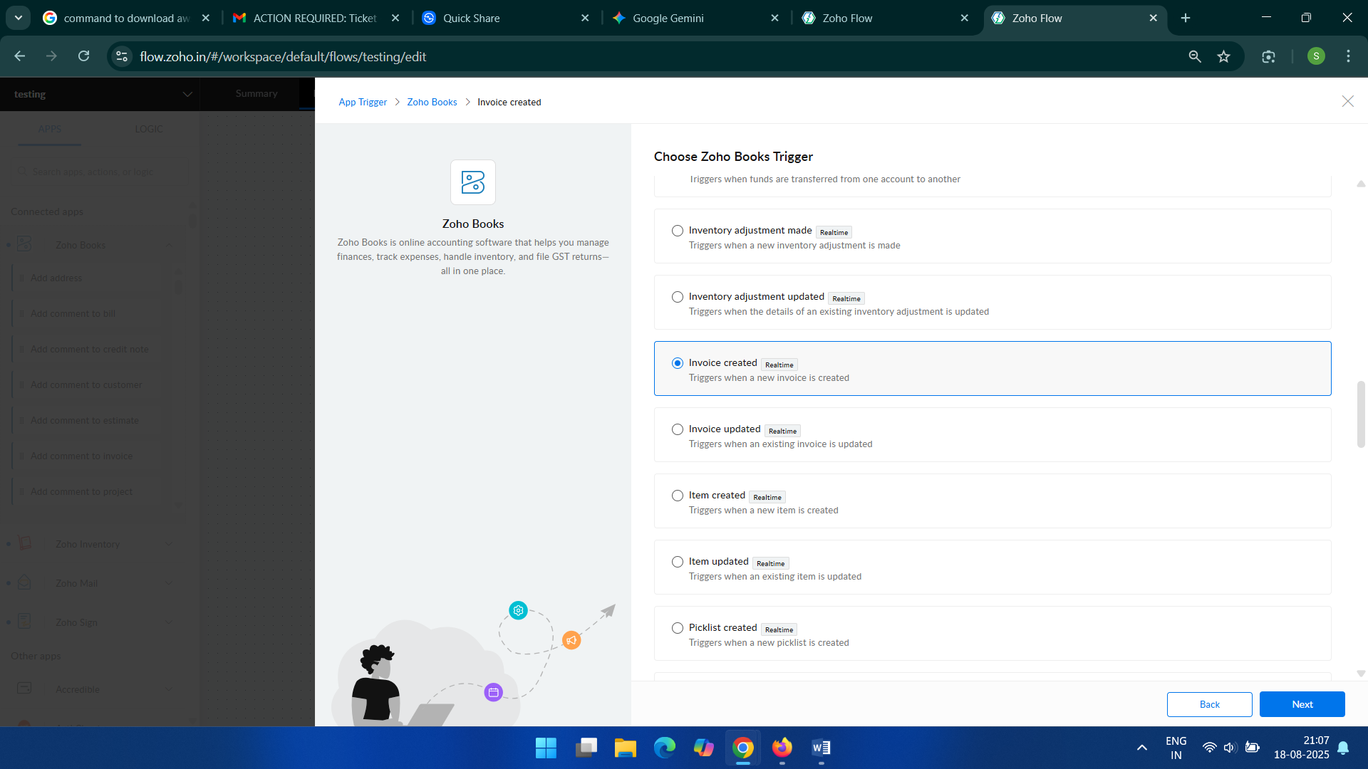

Slide 8
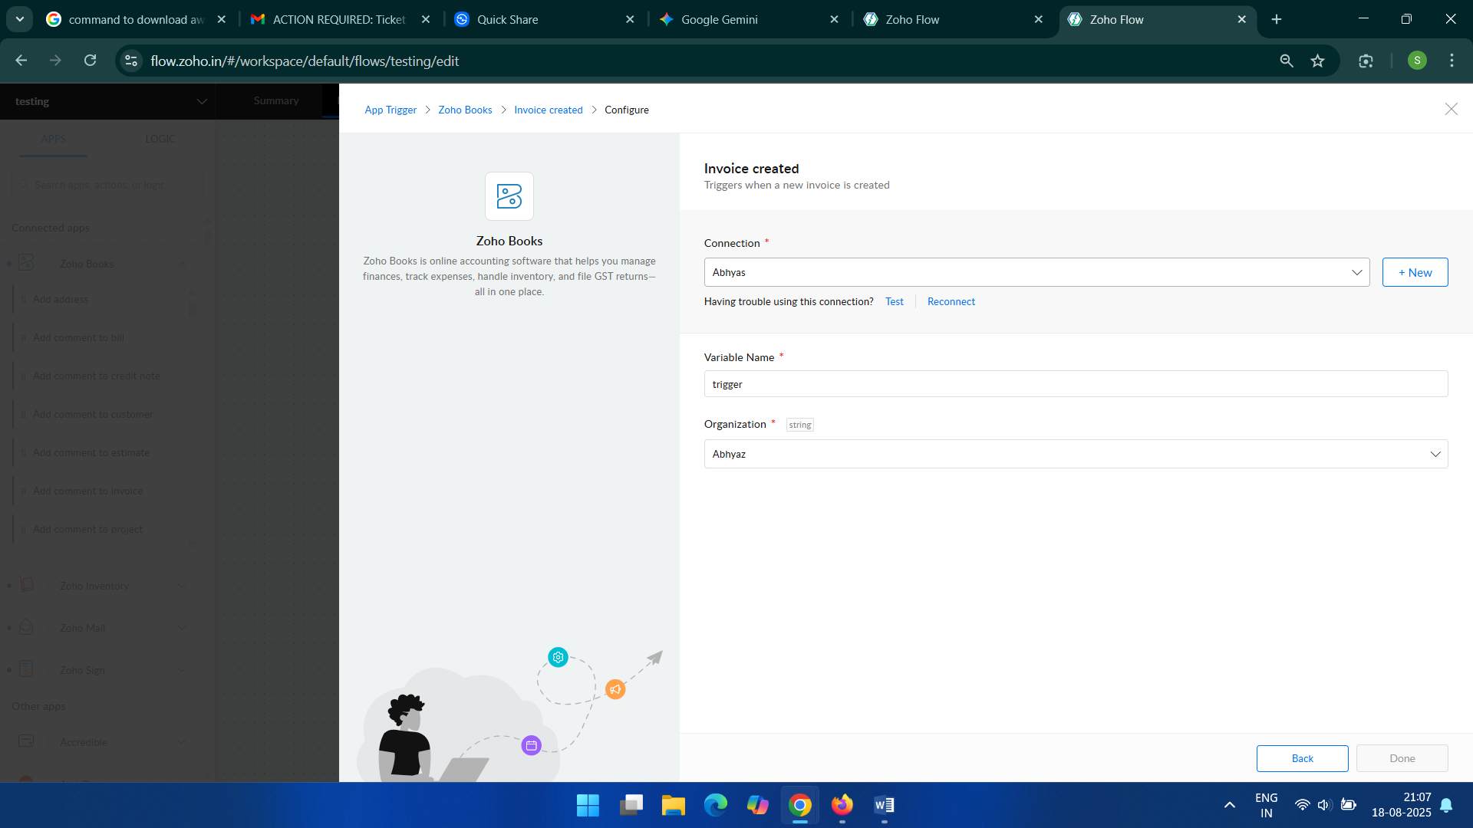

Slide 9
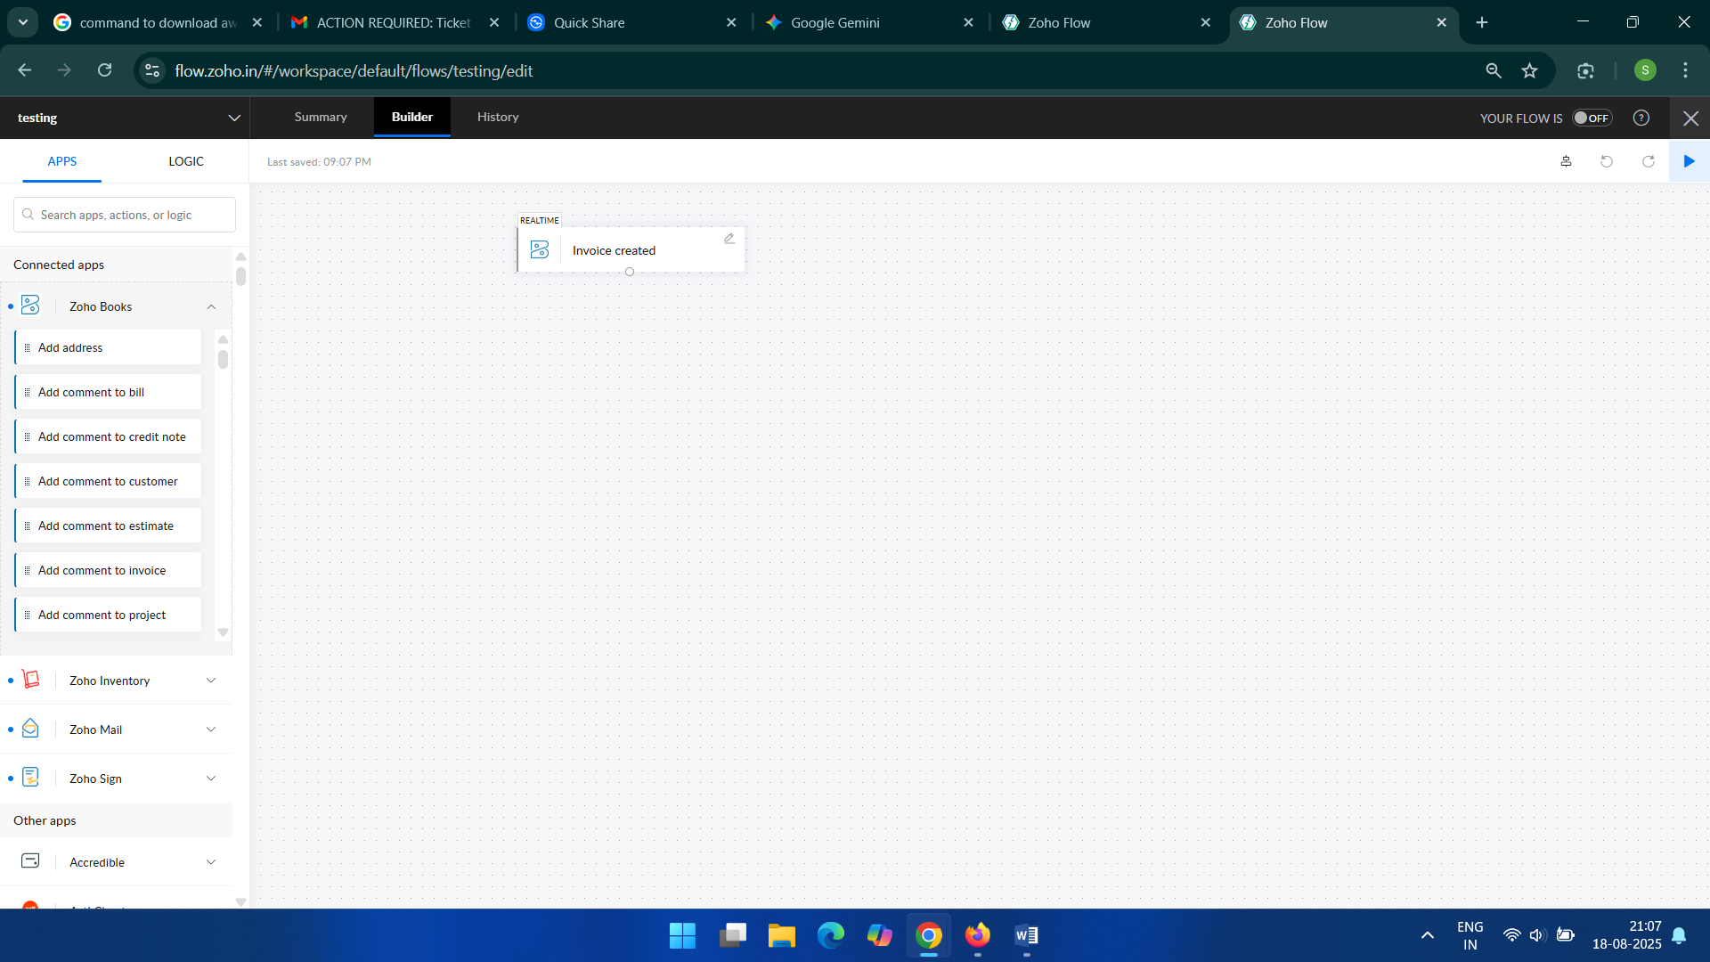
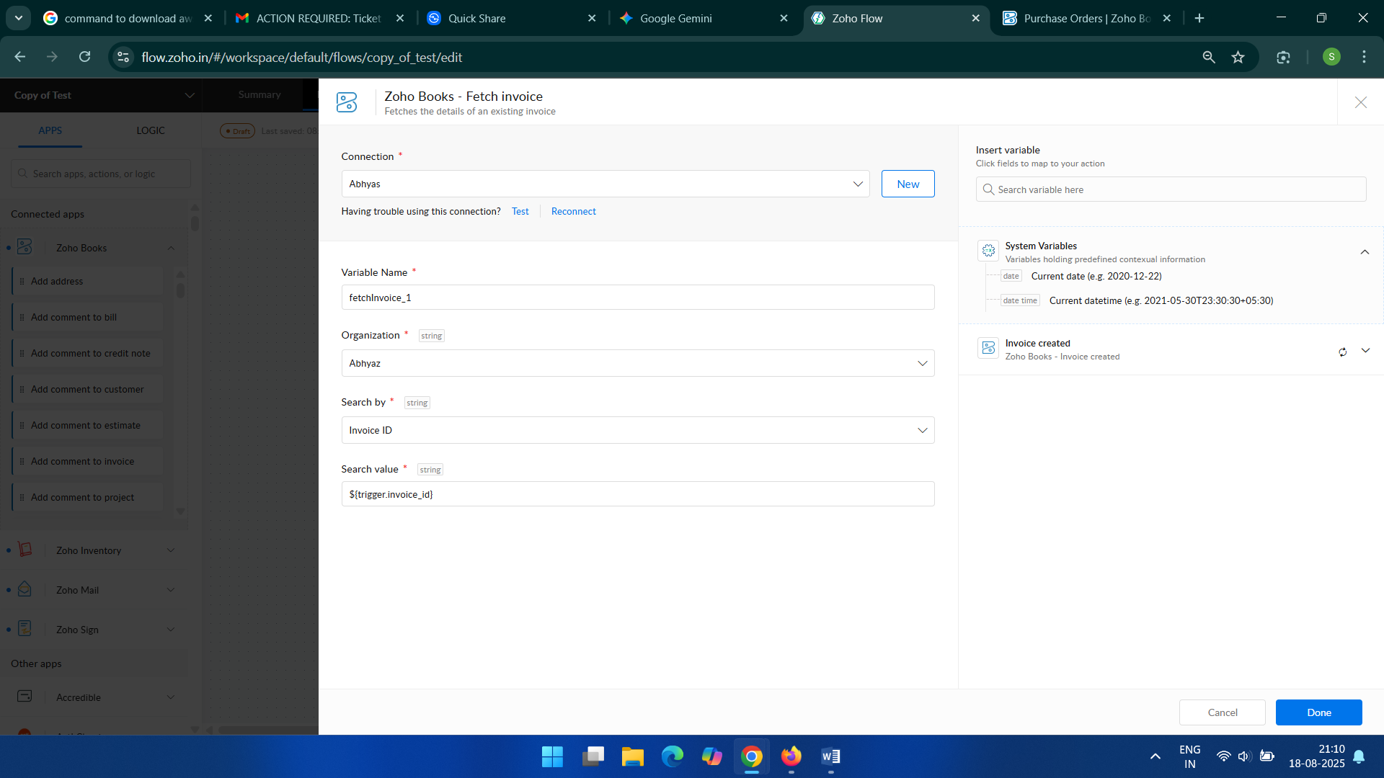

Slide 10
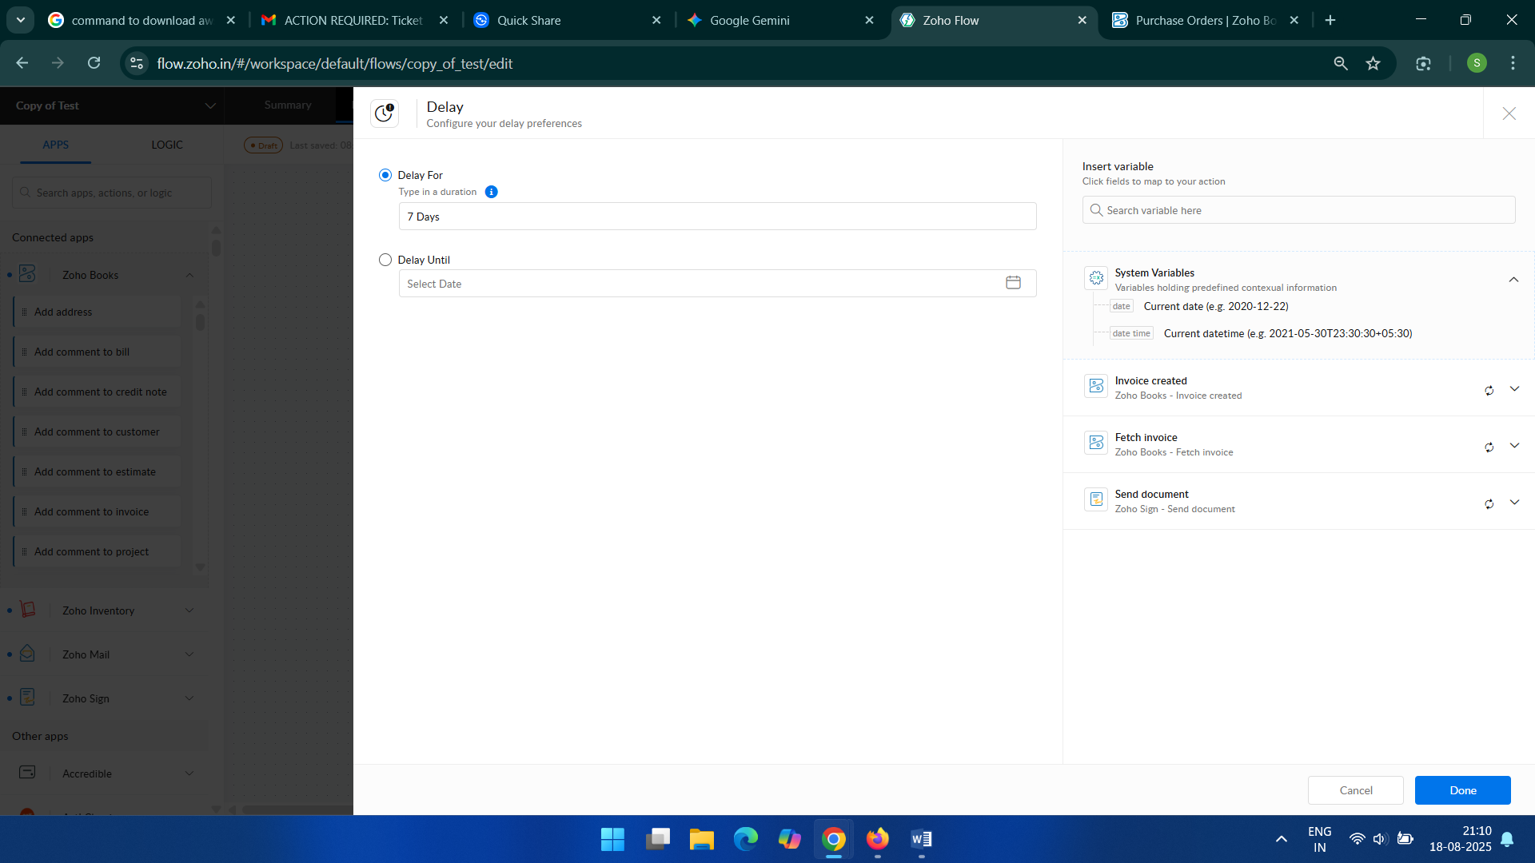

Slide 11
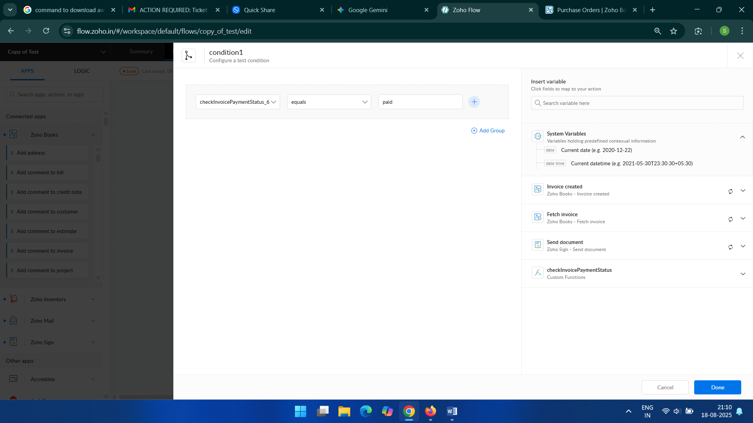

Slide 12


Slide 13
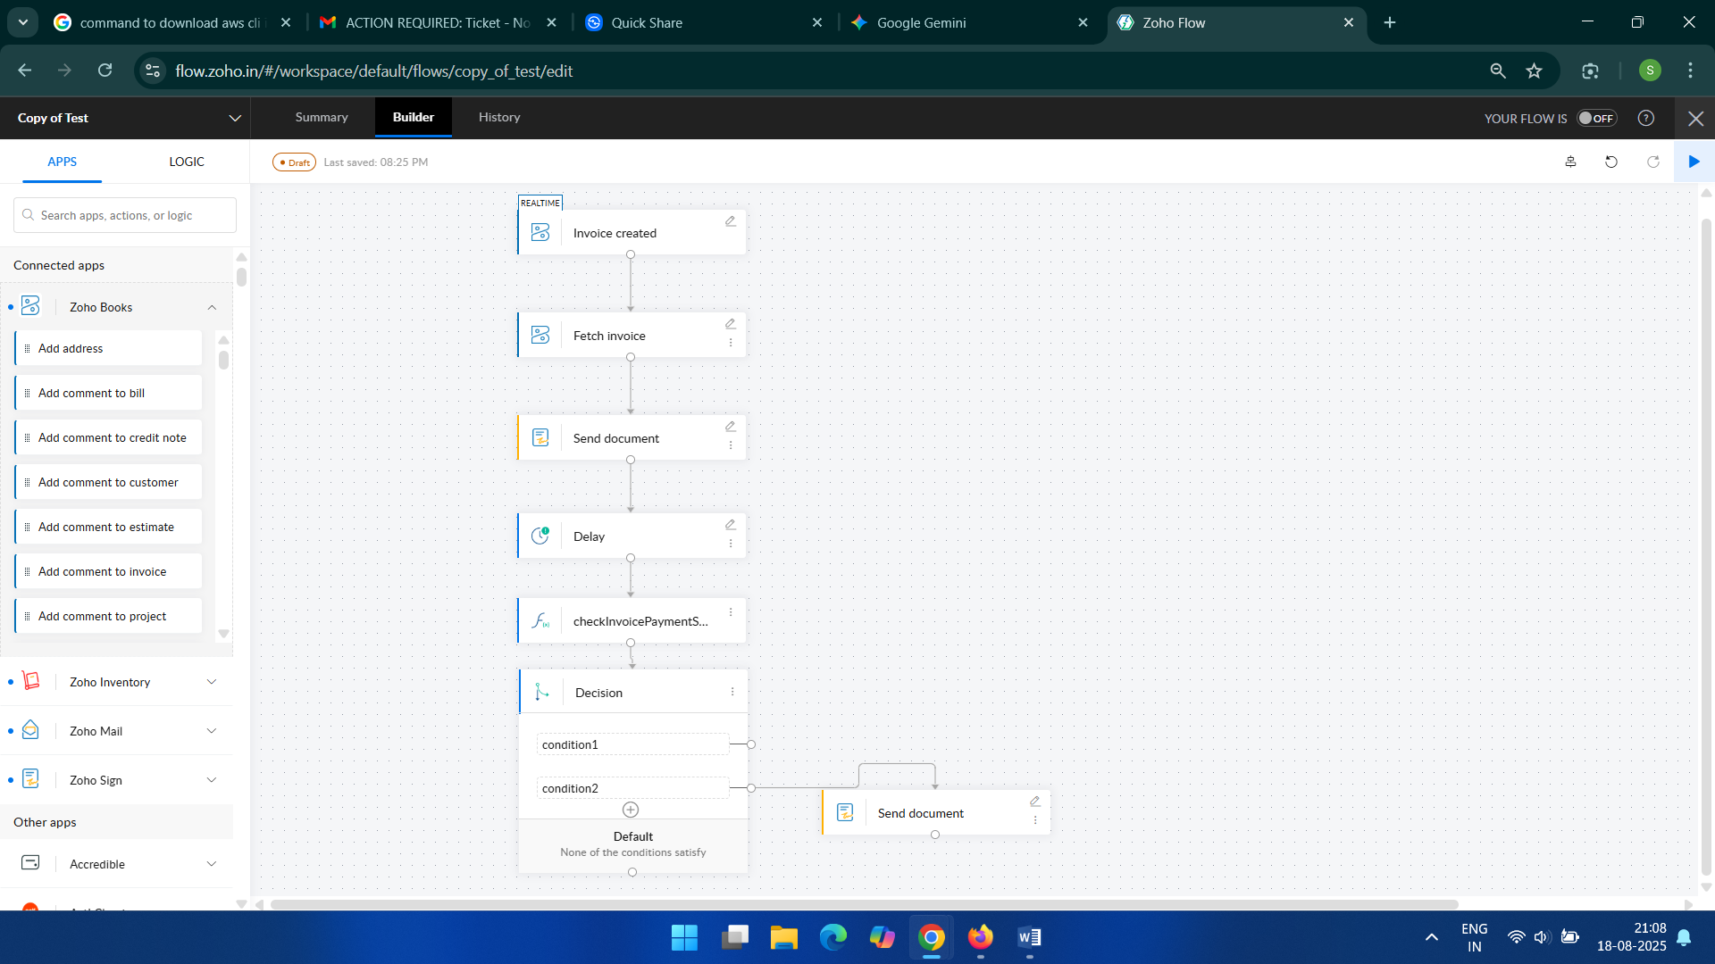

Slide 14
Implementation Stage 3: Configuring the Zoho Books and Email Actions
For the "Fetch Invoice" action, map the Invoice ID from the trigger.
For the first "Send document" action, map the customer's email address and the invoice document from the fetched details.
Set the email subject and body content.
For the "Check invoicePaymentStatus" action, use the invoice ID to get the current status from Zoho Books.
In the "Decision" block, create conditions such as "If payment status is Paid" or "If payment status is Overdue."
For the final "Send document" action, configure it to send a different document based on the decision outcome.

Slide 15
Implementation Stage 4: Testing and Deployment
Create a test invoice in Zoho Books.
Monitor the Zoho Flow history to confirm the flow triggers and executes without errors.
Check the customer's email to verify they received the invoice.
Manually update the payment status of the test invoice to check if the conditional logic works.
Verify that the second "Send document" action triggers under the correct conditions.
Once testing is successful, activate the Zoho Flow.

Slide 16
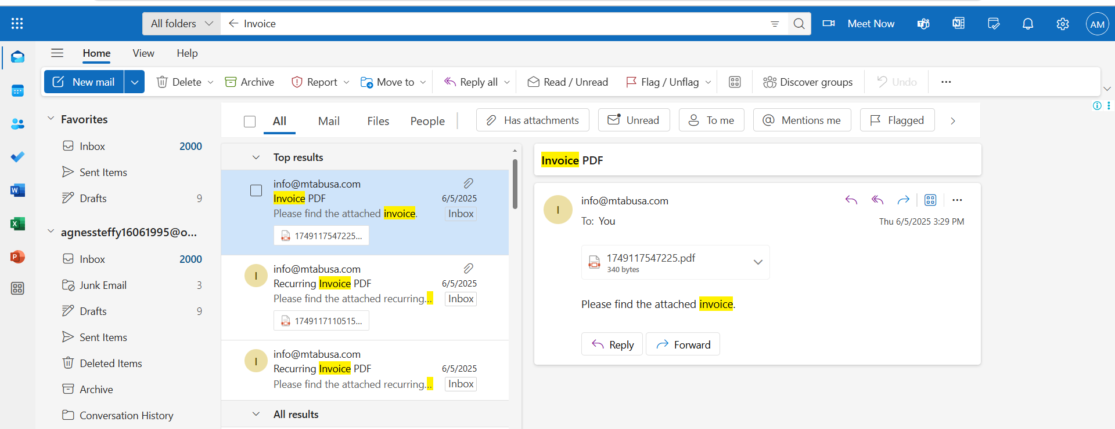
Thus Successfully implemented the Automation flow .

